Slide 1
Regression Analysis
Linear predictive models
Nahel Yaziji

Slide 2
The role of regression analysis in an overall project
Raw data
Raw data
Raw data
Raw data
Data Manipulation
predict the value of a dependent variable, based on one or more input variables
Output
Analysis Dataset
Output
Descriptive Statistics
Regression Analysis
Statistics has often placed an emphasis on projecting from a sample of data to a wider population and identifying whether what we do observe in the sample is likely to have occurred by chance
Post-Estimation Dataset
Post-Estimation Analysis
Output

Slide 3
Model Type
Linear model – often very good for continuous data
Non-Linear (e.g. logistic regression) to handle ‘awkward’ outcomes data with limited values or skewed distributions
Panel Data (e.g. random effects) to account for observations being clustered within units
Survival models to account for skewed outcome measures that are frequently censored
Often determined by nature of the data specifically the limitations of the data and its distributional aspects

Slide 4
Methods of Estimation
Least Squares – minimising (squared) distances between observed and modelled outcomes
Maximum Likelihood – Chooses parameter values which are ‘most likely’ to have produced observed results
Method of Moments – choosing parameter values such that they replicate observed sample properties such as the mean and variance
Most frequently automatically tied to choice of model. E.G. OLS for linear models and maximum likelihood for everything else
But you could use ML for linear model and would give you same answers as OLS under a set of data assumptions.
MM somewhat old-fashioned but now making a bit of a comeback as Generalised MM to address some limitations of ML assumption of distributions

Slide 5
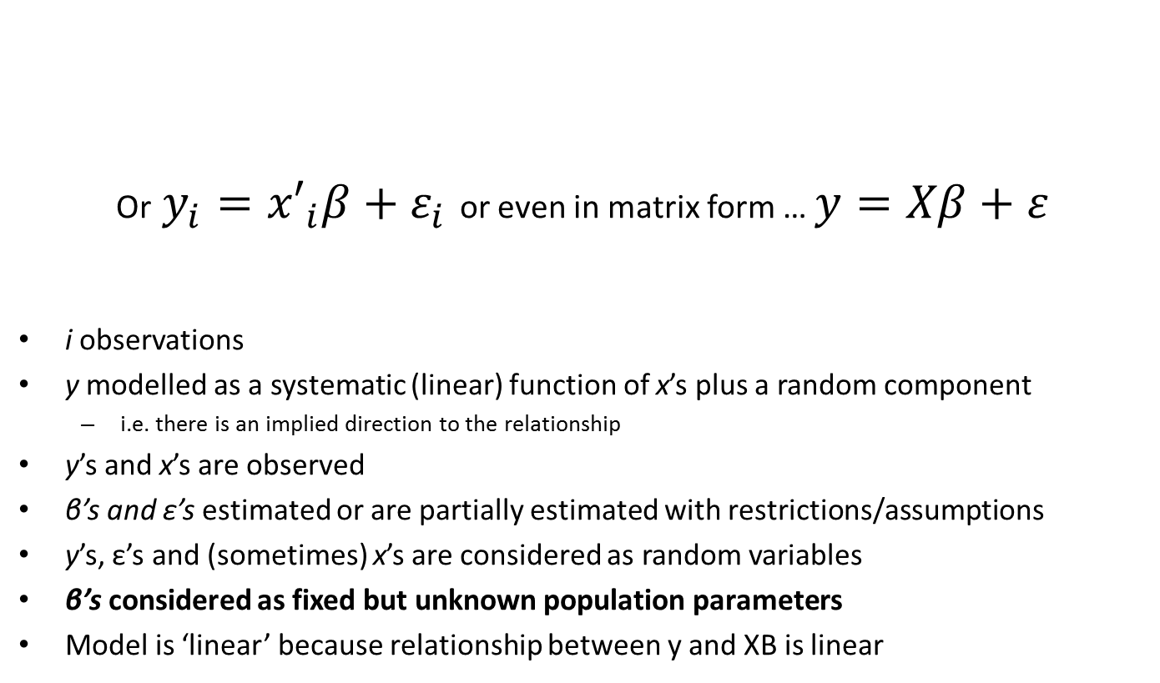
Structure of a linear model
Or $y_{i}={x′}_{i}β+ε_{i}$ or even in matrix form … $y=Xβ+ε$
i observations
y modelled as a systematic (linear) function of x’s plus a random component
i.e. there is an implied direction to the relationship
y’s and x’s are observed
β’s and ε’s estimated or are partially estimated with restrictions/assumptions
y’s, ε’s and (sometimes) x’s are considered as random variables
β’s considered as fixed but unknown population parameters
Model is ‘linear’ because relationship between y and XB is linear
$$y_{i}=β_{0}+β_{1}x_{1i}+β_{2}x_{2i}+ …+β_{n}x_{ni}+ε_{i}$$

Slide 6

Simple linear model estimation with OLS
Fit a simple constant (at the mean of y)
A simple (unbiased) estimate of expected value of y but doesn’t exploit relationship with observed x
No explained variation
y
covar(y,x)
Unexplained variation / residual
$$\overline{y}$$
var(y)
var(x)
x

Slide 7
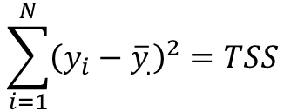

How do we describe the unexplained variation?
If a mean constant is fit, the sum of the residuals always equals zero
Square the residuals and sum
Total Sum of Squares (TSS)
$$\sum_{i=1}^{N}{{(y}_{i}−{\overline{y}}_{.})=0}$$
$$\sum_{i=1}^{N}{{\left(y_{i}−{\overline{y}}_{.}\right)}^{2}=TSS}$$

Slide 8

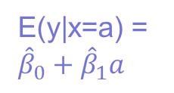



Extending the model
Consider fitting a relationship to x₁ … $y=β_{0}+β_{1}x_{1}$
to better explain variation
Obtain better prediction of y conditional on x
y
$${\hat{β}}_{1}$$
$$\overline{y}$$
Explained/modelled variation
E(y|x=a) = ${\hat{β}}_{0}+{\hat{β}}_{1}a$
Remaining residual
$${\hat{β}}_{0}$$
x= a
x

Slide 9
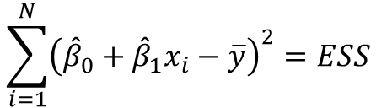
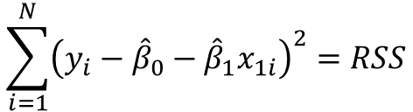
Explaining Variation
Explained Sum of Squares (ESS)
sum of deviations between simple overall mean and new modelled expectation
Residual Sum of Squares (RSS)
sum of squared deviations between observed values and modelled expectation
TSS = ESS + RSS
Amount of variation explained (R-squared)
ESS/TSS or
1- RSS/TSS
$$\sum_{i=1}^{N}{{\left({\hat{β}}_{0}+{\hat{β}}_{1}x_{i}−\overline{y}\right)}^{2}=ESS}$$
$$\sum_{i=1}^{N}{{\left(y_{i}−{\hat{β}}_{0}−{\hat{β}}_{1}x_{1i}\right)}^{2}=RSS}$$

Slide 10
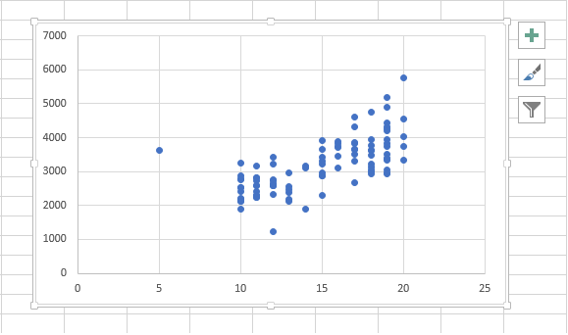
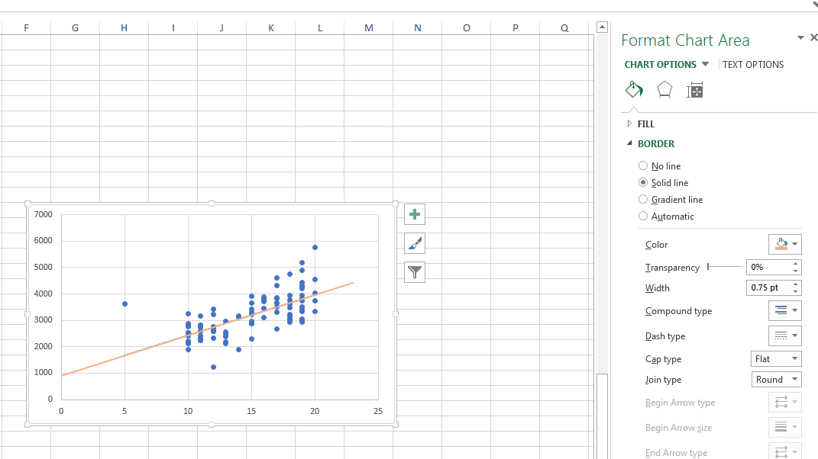
Regression in Excel
1.) Create a scatter plot
2.) Hover over chart, and press green ‘plus’
3.) Tick the radio box for trend-line there are additional options to fit curves as well as straight lines
4.) The trend-line will appear on the chart. Right click the line to ‘format trend-line’
5.) Tick ‘Display Equation on chart’
Step 2
Step 4

Slide 11
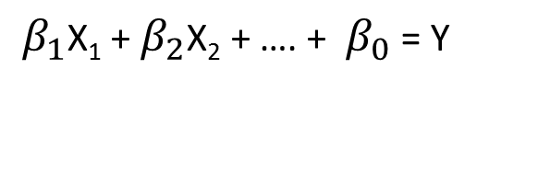
Multiple Linear Regression
In most cases, our output depends on more than one input variable
$β_{1}$X₁ + $β_{2}$X₂ + …. + $β_{0}$ = Y
($β_{1}$ x years of education) + ($β_{2}$ x seniority) + …………………………..+ 40 = Income

Slide 12
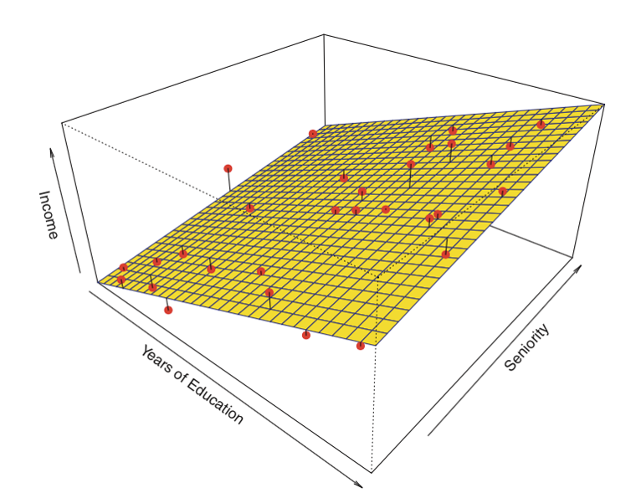
Multiple Linear Regression - visualisation
https://towardsdatascience.com/linear-regression-detailed-view-ea73175f6e86
M₁X₁ + M₂X₂ + c = Y : equation of a plane

Slide 13
Multiple Regression in Excel - instructions
The data analysis toolpak allows you to perform multiple regression in Excel
Install the toolpak (File->Options->Add-Ins)
From the Data Ribbon, select Data Analysis
Select Regression
Select Input Y range – this is your dependent variable (one column)
Select Input X range – these are the independent variables (one column for each variable)
Press OK

Slide 14
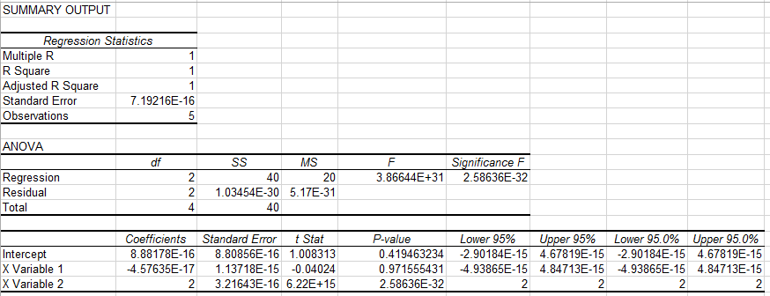



Multiple Regression in Excel - interpretation
Information on how well the line fits the data
Alternative way of assessing model fit
$$β_{0}$$
$$β_{1}$$
$$β_{2}$$

Slide 15
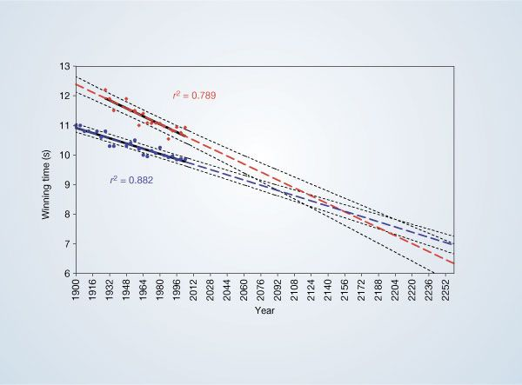
Example – 100m sprint
Linear regression is often a good starting point to understand data
This brief communication plotted the 100m world record times for men and women
Was used to justify that women might be faster than men by 2156
Is this a good model?
Tatem 2004, Nature

Slide 16
Logistic Regression
Used when the dependent variable is a binary outcome (e.g. yes/no, alive/dead)
Independent variable(s) are typically continuous (but also works for categorical and ordinal variables)
Widely used in medicine
Ln $Odd\left(E\right)=β_{0}+β_{1}x_{1i}+β_{2}x_{2i}+ …+β_{n}x_{ni}+ε_{i}$

Slide 17
Regression for Categorical Data
short
medium
long
Female = 1
Male = 0
What’s the probability of being female, given the hair length?
P(y=1|x)
P(Female)
Hair length

Slide 18
Linear separability
P(Female)
Hair length

Slide 19
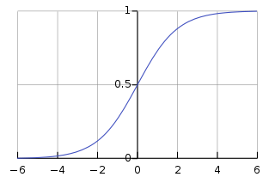
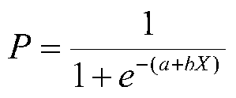
Logistic Function
e is an (irrational) number 2.71828…
https://www.youtube.com/watch?v=AuA2EAgAegE

Slide 20
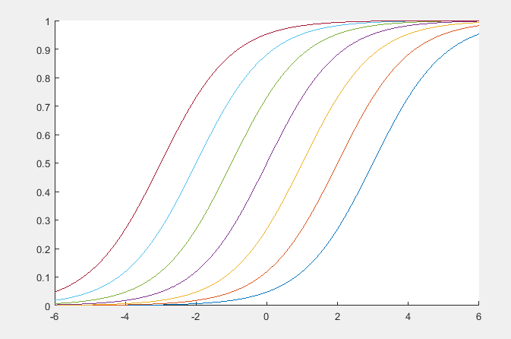
Logistic Function
Set b = 1
Plot what happens when a = -3 to 3
Effect: the ‘start position’ of the ramp changes

Slide 21
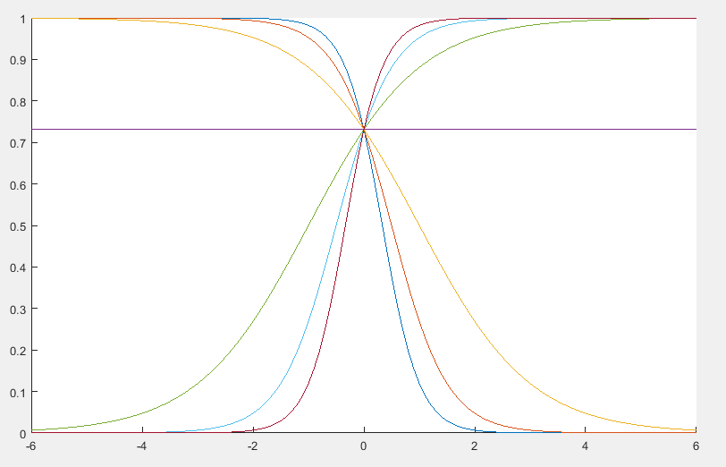
Logistic Function
Set a = 1
Plot what happens when b = -3 to 3
Effect: the ‘steepness’ and ‘direction’ of the ramp changes

Slide 22
Logistic Regression
We use an iterative process to find the most likely S-curve, given the data (Maximum Likelihood Estimation)
Just like linear regression, we need a measure of ‘goodness’ – this is the likelihood function

Slide 23
Logistic Regression example
A Logistic Regression Model for Predicting Health-Related Quality of Life in Kidney Transplant Recipients
https://www.sciencedirect.com/science/article/pii/S0041134507005003?via%3Dihub
Dependent (Outcome) variable: Health-related quality of life (high or low)
Independent variables:
patient gender
age (<45 vs. >45 years)
marital status (married vs. widowed/single)
age at the time of the transplantation (<45 vs. >45 years)
level of education (below vs. above high-school diploma)
monthly family income (below vs. above 300 US$),
duration of End-Stage Renal Disease (ESRD) in months

Slide 24
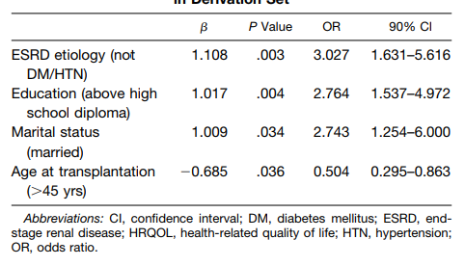
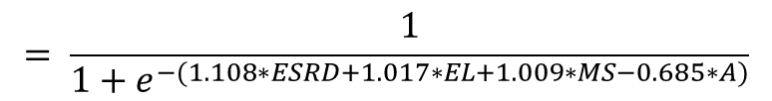
Logistic Regression – real-life example
Logistic model is:
$$= \frac{1}{1+e^{−(1.108∗ESRD+1.017∗EL+1.009∗MS−0.685∗A)}}$$

Slide 25
Logistic Regression – odds ratios
The odds ratio described the strength of the relationship between the input and output variables.
Odds ratio > 1 describes a positive relationship. E.g Quality of score is predicted to be higher when education level is higher.
For continuous inputs, a increase in value by 1, results in a corresponding increase in the outcome, multiplied by the OR. E.g. if ESRD increases by 1, quality of life score is predicted to multiply by 3.027

Slide 26
Logistic Regression in Excel
1.) Install the Solver toolpak (File->Options->Add-Ins)

Slide 27
Logistic Regression in Excel
1.) Install the Solver toolpak (File->Options->Add-Ins)
Solver is not a tool for Logistic Regression, per se. Rather, it solves optimisation problems, which can be applied to many scenarios.

Slide 28
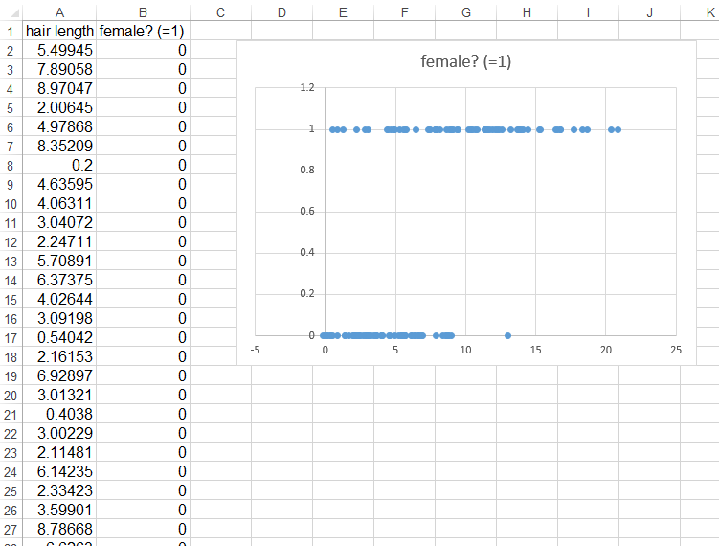
Logistic Regression in Excel
2.) Set out your data
(as we mentioned previously, always sensible to plot data too)

Slide 29
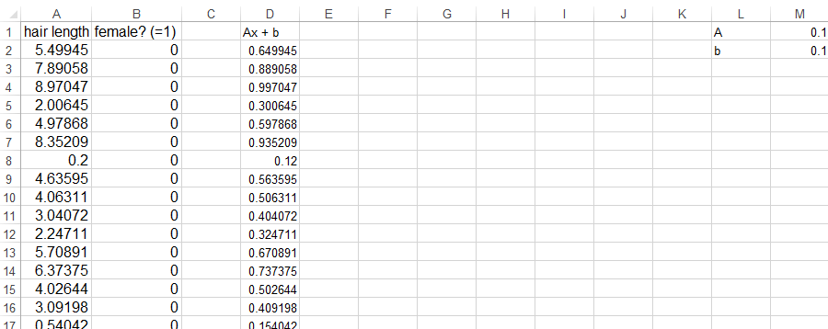
Logistic Regression in Excel
3.) Calculate the exponent
A and b are defined in column M
At the moment, we just put a starting guess for A and b – the computer will work out the best values later.
X is the dependent variable

Slide 30
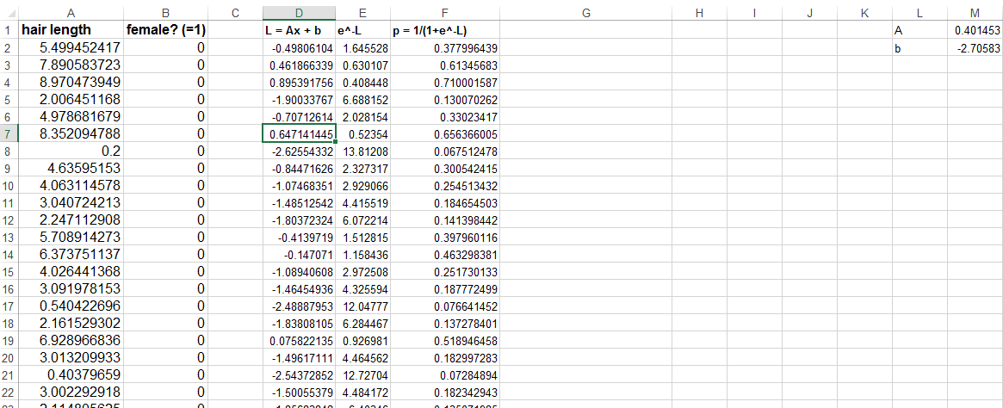
Logistic Regression in Excel
3.) Calculate the probability, using the logistic function (I’ve split this into three steps
Step 1:
Column D = column A x M1 + M2
Step 2:
Column E = e^[column D]
Step 3:
Column F = 1/(1+[column E])

Slide 31
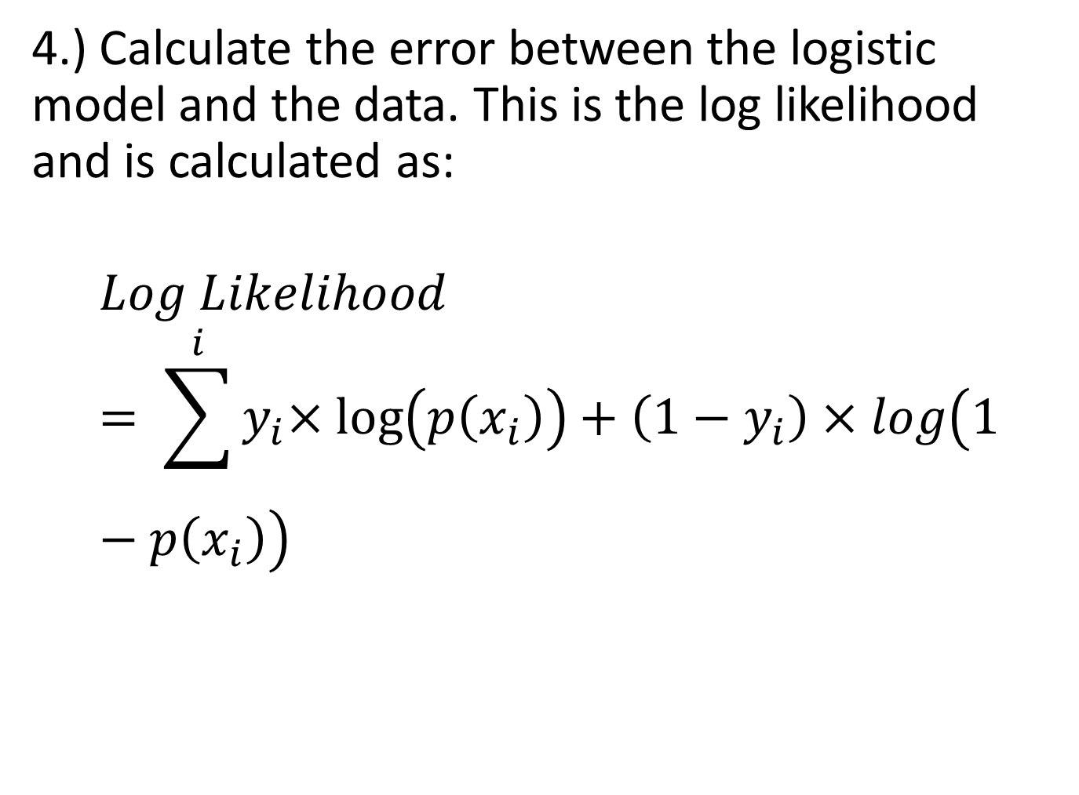
Logistic Regression in Excel
4.) Calculate the error between the logistic model and the data. This is the log likelihood and is calculated as:
$$Log Likelihood= \sum^{i}{{⁡y}_{i}×\log\left(p\left(x_{i}\right)\right)+\left(1−y_{i}\right)×log\left(1−p\left(x_{i}\right)\right)}$$

Slide 32
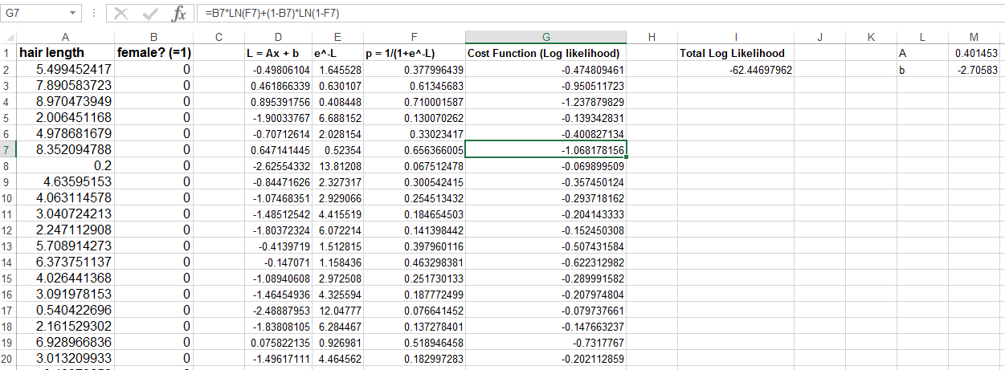

Logistic Regression in Excel
$$Log Likelihood= \sum^{i}{{⁡y}_{i}×\log\left(p\left(x_{i}\right)\right)+\left(1−y_{i}\right)×log\left(1−p\left(x_{i}\right)\right)}$$
Total log likelihood is just the sum of column G

Slide 33
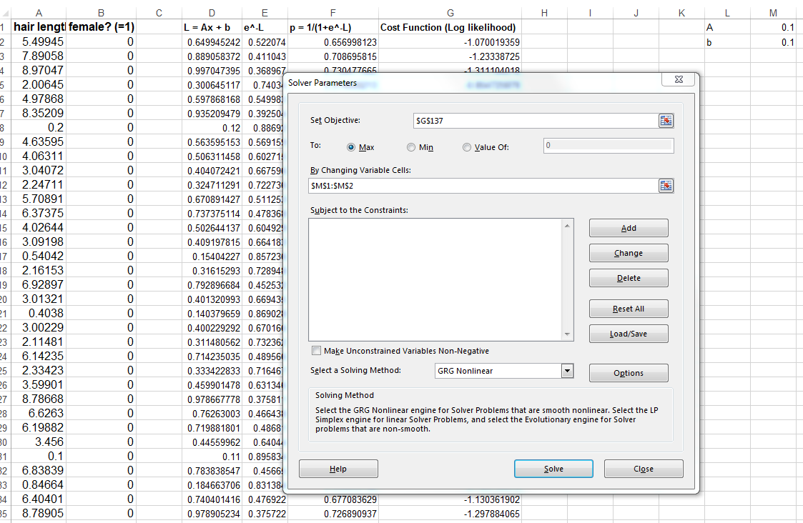
Logistic Regression in Excel
5.) Find the best model parameters using Solver

Slide 34
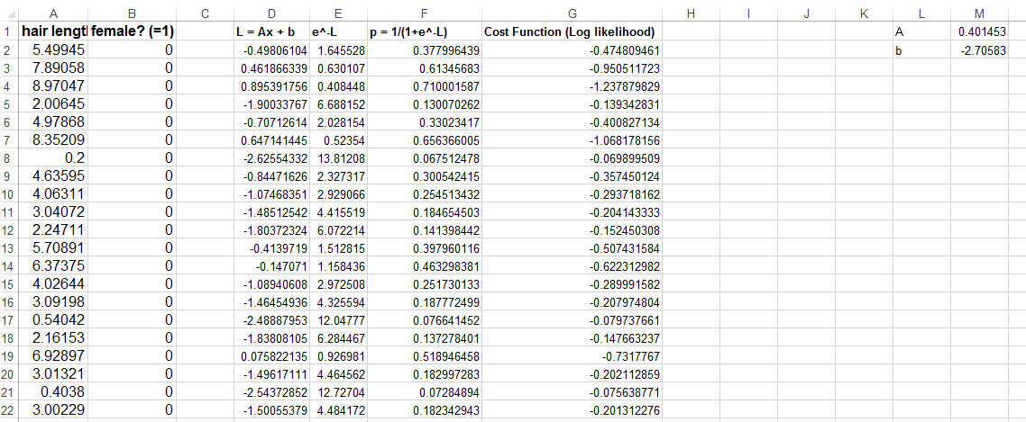
Logistic Regression in Excel
4.) Find the best model parameters using Solver
A and b have changed, meaning that the solver package has managed to optimise these values

Slide 35
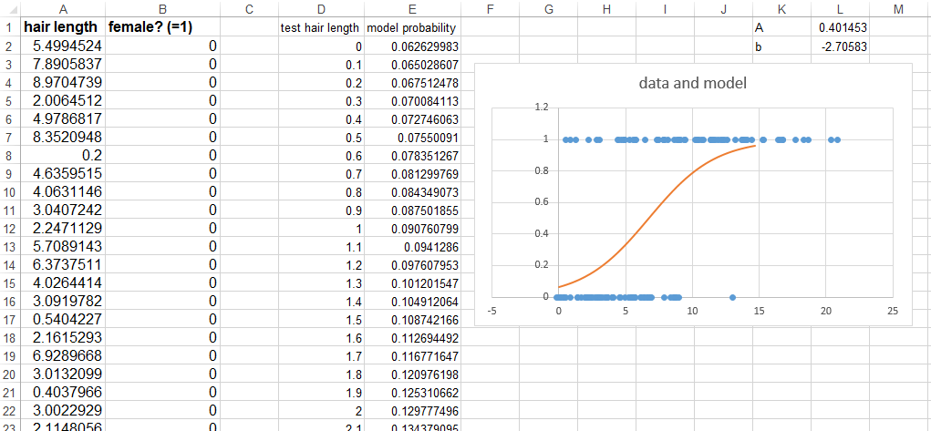
Logistic Regression in Excel
4.) Plot our model (along with the data) to check it is doing something sensible

Slide 36
A note on causality
As we’ve seen, regression models are used to predict an independent (output) variable, based on some combination of the dependent (input) variables.
This does not necessarily mean that there is a cause and effect between the variables. To determine causes, we either use (i) expert domain knowledge, (ii) randomised controlled trials, (iii) causal inference techniques

Slide 37
Summary
Description of regression
Linear regression
Multiple linear regression (or simply, multiple regression)
Logistic regression

